Slide 1
05 | Introduction to Machine Learning
Cynthia Rudin | MIT Sloan School of Management
Notes:
Machine learning is a super powerful set of techniques. They allow you to make predictions and detect patterns that would have otherwise gone unnoticed. Ml started as a subfield of AI, and its goal is to allow humans to learn by example. I’m just going to launch right into it, and give you an introduction to some of the most important machine learning problems.

Slide 2
Introduction to Machine Learning
Classification – Predict answers to Yes/No questions
Regression – Predict real values
Clustering – Find patterns of similar objects
How to Evaluate Machine Learning Models

Slide 3
Classification

Slide 4
Machine Learning
Grew out of artificial intelligence within computer science. Teaches computers by example.
ML is arguably part of statistics.
Is this a chair?
Notes:
Machine learning as a field, *read*
If we want to teach the computer to recognize images of chairs, then we give the computer a whole bunch of images, and tell it which ones are chairs and which are now, and then it’s supposed to learn to recognize chairs, even ones it hasn’t seen before. It’s not like we tell the computer how to recognize a chair, we don’t tell it “a chair has 4 legs and a back and a flat surface to sit on and so on”, we just give it a lot of examples.
Machine learning has close ties to statistics, in fact it’s hard to say what’s different about predictive statistics and machine learning, and these fields are very closely linked right now.

Slide 5

Classification
We have a training set of observations (e.g., labeled images) and a test set that we use only for evaluation.
Training set
Test set
(not a chair)
(chair)
(not a chair)
(chair)
(not a chair)
(not a chair)
(not a chair)
(not a chair)
Notes:
The problem I just told you about is a classification problem where we are trying to identify chairs. The way we set the problem up is that we have a *read*
We use the training set to learn a model of what a chair is. The test set are images that are not in the training set, and we want to be able to make predictions on those, as to whether or not each image is a chair.
It could be that some the labels on the training set are noisy. That could happen. In fact one if these labels is noisy *point*. That’s ok, because as long as their isn’t too much noise, we should still be able to learn a model for a chair. It just won’t be able to classify perfectly, and that happens. Some prediction problems are harder than others, but that’s ok, we just do the best we can from the training data. And in terms of the size of the training data, the more the merrier. We want as much data as we can to train these models.

Slide 6


Classification
Each observation is represented by a set of numbers (features).
Each pixel gets rgb values like [1.0,0.9,0.8]
Image becomes:
[1.0,0.9,0.8,0.1,0.5,…]
(Label is -1, it’s not a chair)
Notes:
How do we represent an image of a chair, or a flower, or whatever, in the training set? I just zoomed in on a piece of this image over here, and you can see that the pixels in the image. We can represent each pixel according to its rgb values (red green blue), so we get three numbers representing each image. So you can represent the whole image as a collection of rgb values. So the image becomes this very large vector of numbers. And in general, when doing machine learning, we need to represent each observation in the training and test sets as a vector of numbers. The label is also represented by a number. Here the number is -1 because the image is not a chair. The chairs would all get label +1.

Slide 7
Classification
Each observation is represented by a set of numbers (features).
Manhole is represented as: [ 5 3 120 12 1 0 ….. ]
Inspected?
Vented cover?
Number of events last year
Number of electrical cables
Number of serious events last year
Number of pre-1930 electrical cables
Notes:
Here’s another example. This is a problem that comes from NYC’s power company, where they wanted to predict which manholes were going to have a fire. So we would represent each manhole as a vector, and here are the components in the vector. The first component might be *read*.
In general, the first step is to figure out how to represent your data as a vector. You can make the vector very large, you can include lots of factors if you like, that’s fine. Computationally things are easier if you use fewer features, but then you risk leaving out information. So there’s a tradeoff right there that you will have to worry about, and we’ll talk more about that later. But in any case, you can’t do ML if you don’t have your data represented this way, so that’s the first step. *pause*
You’d think that manholes with more cables, more recent serious events, etc. would be more prone to explosions and fires in the future. But what combination of them would give you the best predictor? How do you combine them together? You could add them all up but that might not be the best thing. You could give them all weights and add them up, but how do you know the weights? That’s what ML does for you. It tells you what combinations to use to get the best predictors.

Slide 8
Classification
Each observation is represented by a set of numbers (features).
Manhole is represented as: [ 5 3 120 12 1 0 ….. ]
Inspected?
Vented cover?
Number of events last year
Number of electrical cables
Number of serious events last year
Number of pre-1930 electrical cables
Training feature data is from 2014 and before
(Label is 1, it exploded in 2013)
Notes:
For the manhole problem, we want to use the data from the past to predict the future. So, for instance, the feature data might be from 2014 and before.

Slide 9
Classification
Each observation is represented by a set of numbers (features).
Manhole is represented as: [ 5 3 120 12 1 0 ….. ]
Inspected?
Vented cover?
Number of events last year
Number of electrical cables
Number of serious events last year
Number of pre-1930 electrical cables
Training feature data is from 2014 and before
Label is 1 if it had an event in 2015
Notes:
*read* so that’s our training set.

Slide 10
Classification
Each observation is represented by a set of numbers (features).
Manhole is represented as: [ 5 3 120 12 1 0 ….. ]
Inspected?
Vented cover?
Number of events last year
Number of electrical cables
Number of serious events last year
Number of pre-1930 electrical cables
Testing feature data is from 2015 and before
Predict what happen in 2016
Notes:
*Read* we predict the labels for 2016.

Slide 11
Classification
Each observation is represented by a set of numbers (features).
Manhole is represented as: [ 5 3 120 12 1 0 ….. ] -1
[ 0 0 89 5 1 1 ….. ] 1
[ 1 0 20 0 0 1 ….. ] -1
: :
Features, called X
Labels, called Y
(Predictors, Covariates, Explanatory Variables, Independent Variables)
Notes:
Just to be formal about it, *Read*
The features are also called *read* so you can choose whatever terminology you like.

Slide 12
Classification
Formally, given training set (x_{i,}y_{i}) for i=1…n, we want to create a classification model f that can predict label y for a new x.
Notes:
Even more formally, we are given a training set of feature label pairs xi yi, and there are n of them, and

Slide 13
Classification
Formally, given training set (x_{i,}y_{i}) for i=1…n, we want to create a classification model f that can predict label y for a new x.
Manhole is represented as: [ 1925 15]
Year oldest cable installed
Number of events last year
Notes:
Let’s take a simple version of the manhole example where we have only two features, *Read*. So each observation can be represented as a point on a 2d graph, which means I can plot the whole dataset.

Slide 14
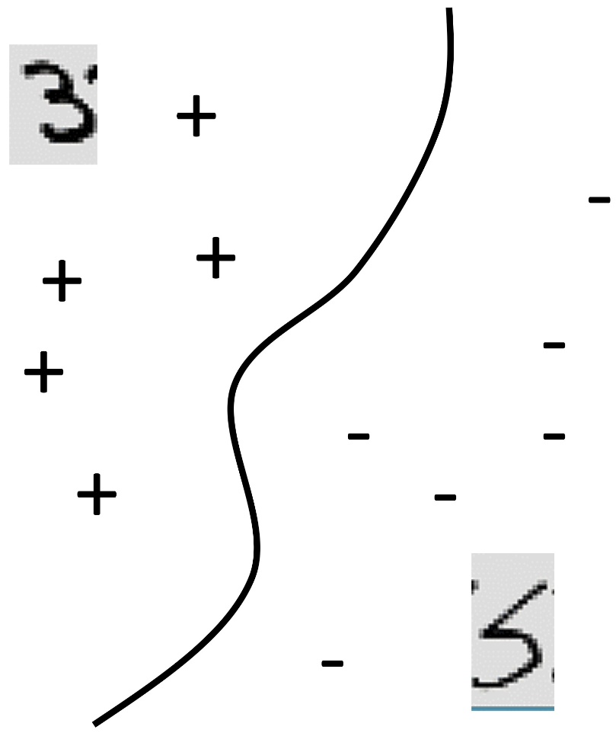
Classification
Formally, given training set (x_{i,}y_{i}) for i=1…n, we want to create a classification model f that can predict label y for a new x.
20
Manhole is represented as: [ 1925 15]
Events Last Year
Year oldest cable installed
Number of events last year
0
1925
Oldest cable
2015

Slide 15
Classification
Formally, given training set (x_{i,}y_{i}) for i=1…n, we want to create a classification model f that can predict label y for a new x.
20
f(x)>0
f(x)=0
f(x)<0
Manhole is represented as: [ 1925 15]
Events Last Year
Year oldest cable installed
Number of events last year
0
1925
Oldest cable
2015

Slide 16
Classification
Formally, given training set (x_{i,}y_{i}) for i=1…n, we want to create a classification model f that can predict label y for a new x.
20
f(x)>0
f(x)=0
f(x)<0
f(x) = function(Events Last Year, Oldest Cable)
Events Last Year
0
1925
Oldest cable
2015

Slide 17
Classification
Formally, given training set (x_{i,}y_{i}) for i=1…n, we want to create a classification model f that can predict label y for a new x.

Slide 18
Classification
Formally, given training set (x_{i,}y_{i}) for i=1…n, we want to create a classification model f that can predict label y for a new x.
The machine learning algorithm will create the function f.
The predicted value of y for a new x is sign(f(x)).
Notes:
. It might be very complicated, but the way to use is is not complicated:

Slide 19
Classification
Yes/No questions – binary classification
automatic handwriting recognition, speech recognition, biometrics, document classification, spam detection, predicting credit default risk, detecting credit card fraud, predicting customer churn, predicting medical outcomes (strokes, side effects, etc.)
Notes:
You can do a lot if you can answer yes/no questions. For instance, think about handwriting recognition. For each letter on a page, we’re going to evaluate whether it’s a letter A, yes or no. Your spam detector in your computer has machine learning in it – each email that comes in has to be evaluated as to whether or not it is spam. Credit defaults – whether or not you get a loan depends on whether the bank predicts that you’re going to default on that loan or not, yes or no. In my lab, we do a lot of work on predicting medical outcomes. We want to know whether something will happen to a patient within a particular period of time.

Slide 20
Classification
Common algorithms:
Logistic Regression (with L1 or L2 regularization)
Decision Trees / Classification Trees / CART / C4.5 / C5.0
AdaBoost (Boosted Decision Trees)
Support Vector Machines
Random Forests
Neural Networks
You never need to program these.
Notes:
Most likely, unless you’re interested in developing your own algorithms, you will never need to program these yourself, they are already programmed in by someone else. If you’re just going to be a consumer of these, you can use the code that’s already written for them. All of these are covered in the intro to ML course. But in order to use them effectively, you have to know what they are doing. Otherwise you could run into issues. But if you can figure out how to use these, you have an extremely powerful tool on your hands.

Slide 21
Notes:
case study

Slide 22
Regression
Notes:
regression

Slide 23
Regression
For predicting real-valued outcomes:
How many customers will arrive at our website next week?
How many tv’s will we sell next year?
Can we predict someone’s income from their click through information?
Notes:
Supervised regression = regression

Slide 24
Regression
Each observation is represented by a set of numbers.
Income
A person is represented as: [ 5 3 120 12 1 0 ….. ] 84
[ 0 0 89 5 1 1 ….. ] 32
[ 1 0 20 0 0 1 ….. ] -10
: :
Features, called X
Labels, called Y

Slide 25
Regression
Each observation is represented by a set of numbers.
Income
A person is represented as: [ 5 ] 84
[ 0 ] 32
[ 1 ] -10
:
Single feature, called X
Labels, called Y

Slide 26
Regression
Formally, given training set (x_{i,}y_{i}) for i=1…n, we want to create a regression model f that can predict label y for a new x.
1,000K
f(x) = function(Number of Businessweek clicks)
f(x)
Income
0
2000
0
Number of Businessweek clicks

Slide 27
Regression
Formally, given training set (x_{i,}y_{i}) for i=1…n, we want to create a regression model f that can predict label y for a new x.
1,000K
f(x) = function(Number of Businessweek clicks)
f(x)
Income
(Overfitting?)
0
2000
0
Number of Businessweek clicks

Slide 28
Regression
Formally, given training set (x_{i,}y_{i}) for i=1…n, we want to create a regression model f that can predict label y for a new x.
1,000K
f(x) = function(Number of Businessweek clicks)
= 5K*Number of Businessweek clicks + 100K
f(x)
Income
(Underfitting?)
0
2000
0
Number of Businessweek clicks

Slide 29
Regression
Formally, given training set (x_{i,}y_{i}) for i=1…n, we want to create a regression model f that can predict label y for a new x.
1,000K
f(x) = function(Number of Businessweek clicks)
f(x)
Income
(Just right?)
We’ll talk more about this later
0
2000
0
Number of Businessweek clicks

Slide 30
Regression
Formally, given training set (x_{i,}y_{i}) for i=1…n, we want to create a regression model f that can predict label y for a new x.
Estimated income:
f(x) = function(Number of visits to upscale furniture websites, Number of Businessweek clicks, Number of distinct people emailed per day, Number of purchases of over 5K within the last month, Number of visits to airlines, etc.)
For instance,
f(x) = 3*Number of visits to upscale furniture websites
+10*Number of Businessweek clicks
+100*Number of distinct people emailed per day
+2*Number of purchases of over 5K within the last month
+10*Number of visits to airlines
But f(x) could be much more complicated
Notes:
Could include number… times number of ..., Or if could have a complicated function like log or square root in it.

Slide 31
Regression Applications
Predict monetary amounts
Predict consumption or demand for products/energy

Slide 32
Supervised Learning
“Supervised” means that the training data has ground truth labels to learn from. Classification and Regression are supervised learning problems.
(Supervised) classification often has +1 or -1 labels.
(Supervised) regression has numerical labels.
Supervised learning algorithms are much easier to evaluate than unsupervised ones.
Notes:
There are lots of other supervised problems.

Slide 33
Publishing Web Services
Stephen F Elston | Principle Consultant , Quantia Analytics, LLC

Slide 34
Overview
Overview of web services
Publishing models as a web service
Using web services from Excel

Slide 35
Why Web Services?
Publish machine learning solutions
Enable users to take action!
Numerical and graphical results
Integrate with desktop tools
BI tools
Excel
Interactive and batch operations

Slide 36
What is a web service?
Input
Request
Col1 | Col2
Val11 | Val12
Val21 | Val22
Azure ML Service
Output
Response
Score
Out1
Out2
Secure
end point
User Application

Slide 37
Azure ML Web Services Data Flow
Published Input
Input Transformations
Score Trained Model
Output Transformation
Published Output

Slide 38
Publishing Azure ML web services
Automated process
Creates end point
Unique URL
Keep API key secret!
RESTful API
Auto-generated code in C#, Python and R
Secure HTTPS connection

Slide 39
Preparing experiment to publish
Data must flow straight though
Process single row at a time
No aggregations!
Most modules create a transform
Remove any modules requiring multiple data values - no transform
May need to edit R or Python code
Add Select Columns module to end of data flow

Slide 40
Web Services Tips
Reduce number of output columns
Most modules create transforms
For example, scaling or model
If no transform manual edit operations requiring multiple rows
Modules with no transform
Certain custom code

Slide 41
Retraining published web services
Why retrain?
More data
Better model
Simple update
Run Training Experiment
Update Scoring Experiment
Keep the schema the same!
URL and key unchanged

Slide 42
Retraining published web services
Why retrain?
More data
Better model
Simple update
Run Training Experiment
Update Scoring Experiment
URL and key unchanged

Slide 43
Azure ML Excel Web Services
Downloadable Excel file
Excel Azure ML plug-in
API key is secret
Excel Online from OneDrive
Shareable
Batch or row at a time (RSS)

